Slide 1

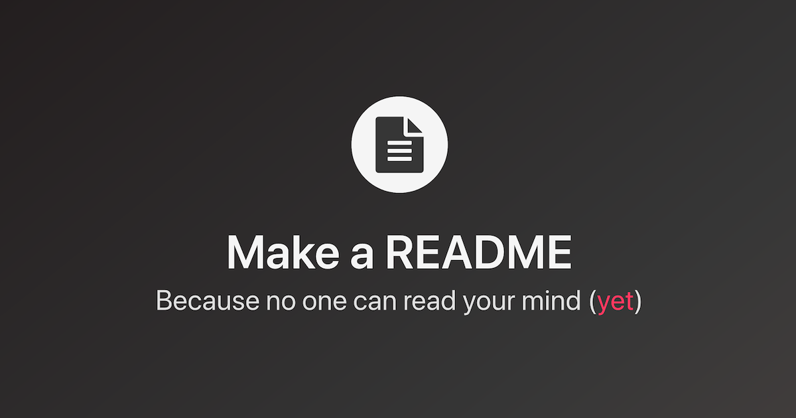
README

Slide 2
README.md
WHY make it?
A README is often the first item a visitor will see when visiting your repository. README files typically include information on: What the project does. Why the project is useful.
Credit your sources
Explain the design and development process
Demonstrate your testing
Show your thought process
What is it?
In simple words, we can describe a README file as a guide that gives users a detailed description of a project you have worked on.
Displayed when your github repo is viewed
A crucial part of the development process
What is required in it?
Project overview
UX with user stories
Manual testing
Deployment
Crediting sources
Knows bugs
Future features
How is it made?
Markdown language
.md file extension
Created and lives in your project folder

Slide 3
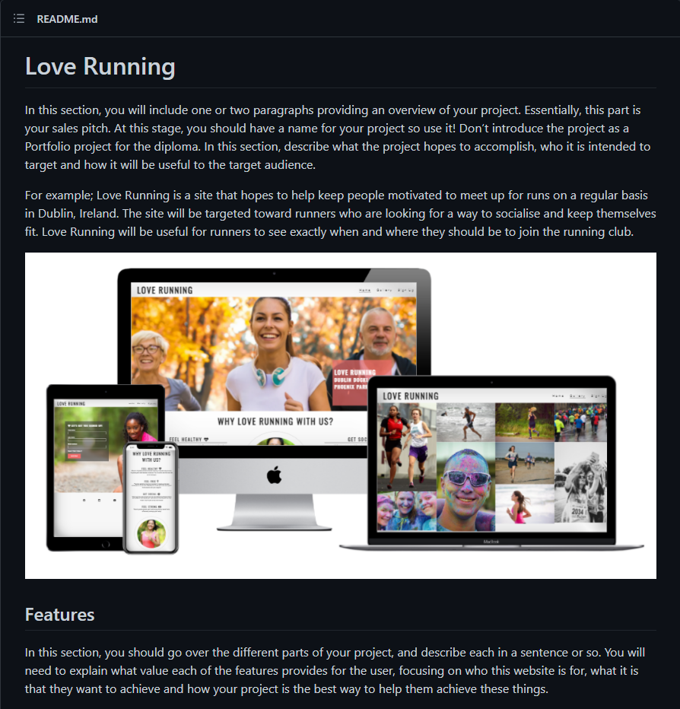
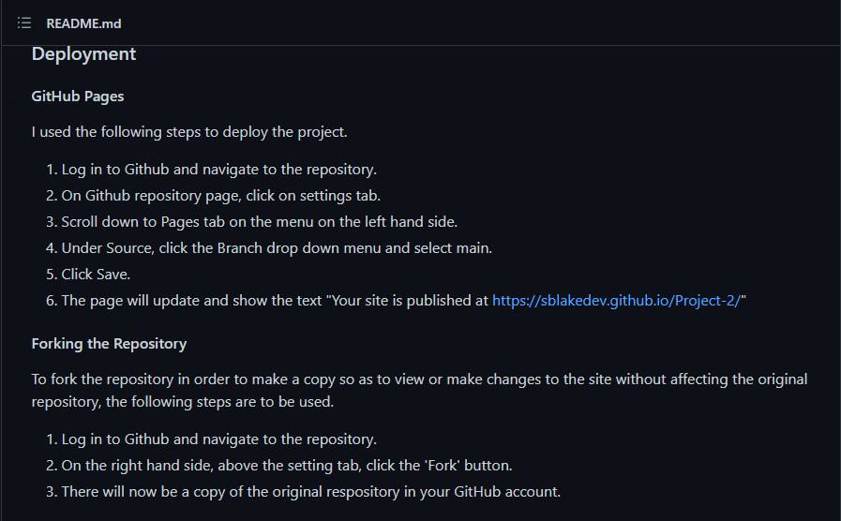
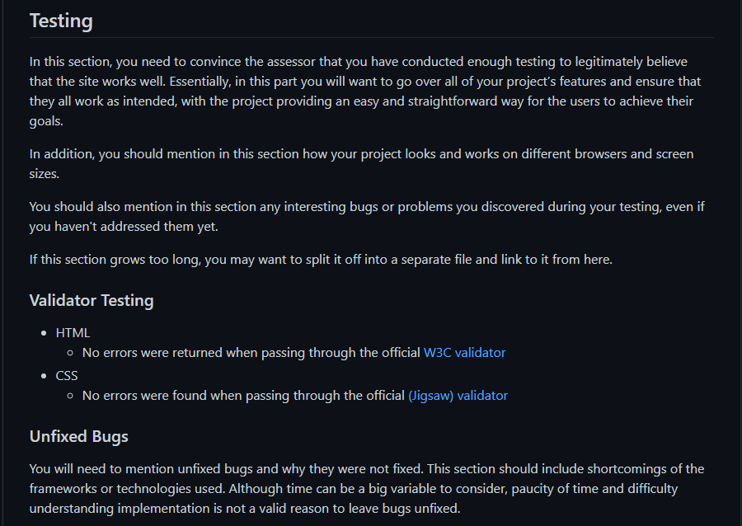
README Sections
Important readme sections
Project overview
List of features
UX/UI
Testing
Deployment
Citation of ALL sources(code, images, text)
Future features
Known Bugs

Slide 4
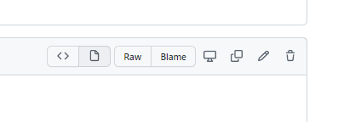
README CI TEMPLATE
Use CI README Template
Click on Raw to reveal the code
Paste code to your Workspace and fill in with project specific information

Slide 5
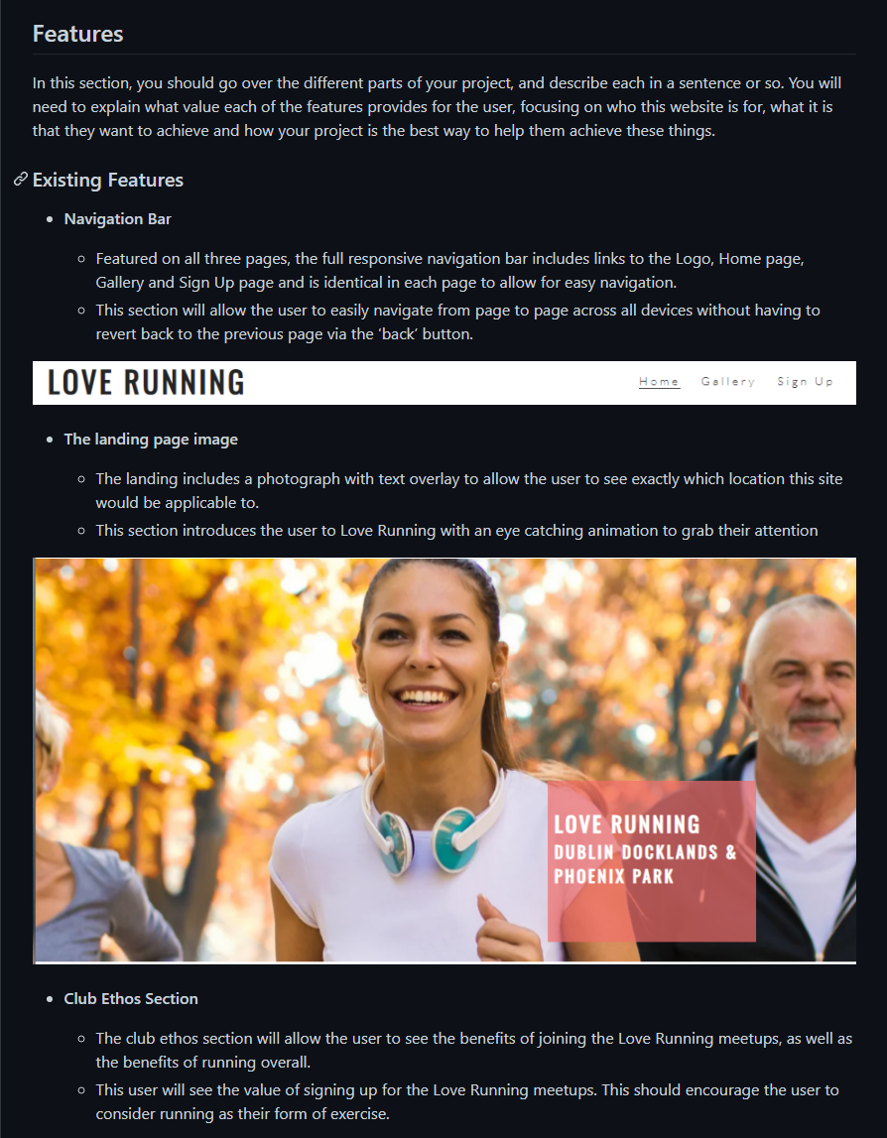
List of Features
Structure of features section
Feature name
A description about the feature and how it works
Screenshot image of the feature
Feature
About
Image

Slide 6
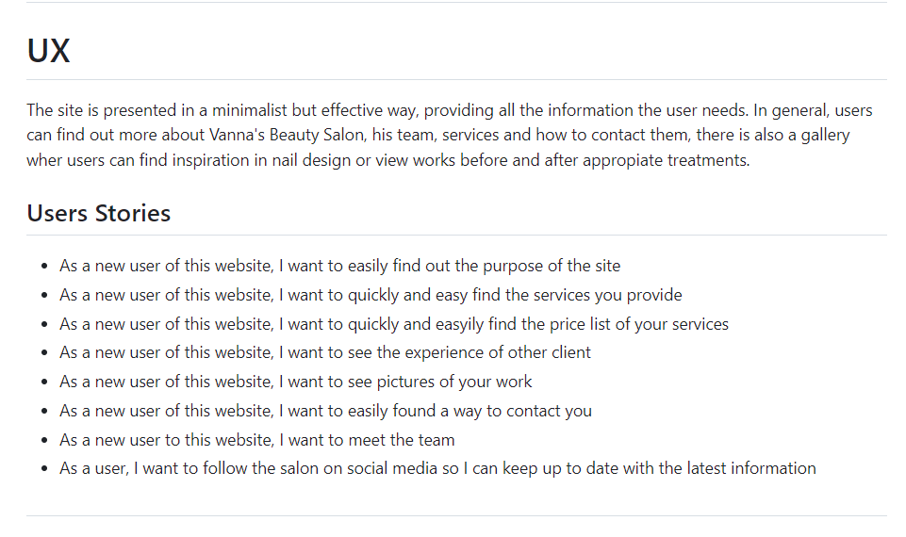
UX/UI Section
This section is for showing your
site goals
design thought process
planning and wireframe design
The sections you should have here
Site Goals
Design choices
User stories
Wireframes
Anything else you want to add that relates to UX/UI

Slide 7
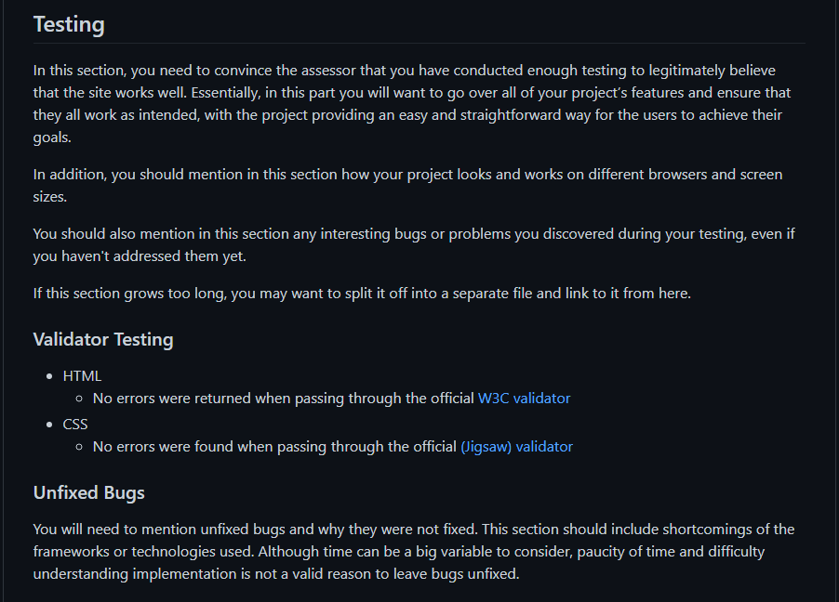
Writing the Testing Section
The testing section should be used to
show the assessor you have tested your site well
show that your site is responsive on multiple devices
test user stories
show that your code passes validation
list any unfixed bugs in your code

Slide 8
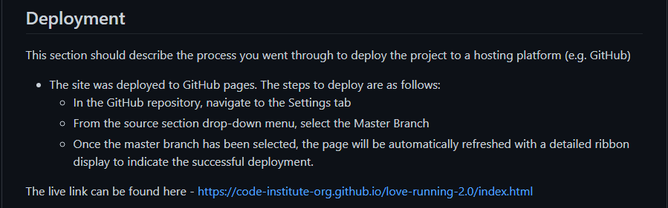
Deployment
Why have the deployment section
What to have in the deployment section
Show the assessor you know how to deploy your project
Show future collaborators and clients how to use your software
Have a record for your future self as a reminder of how to deploy on the platform
Detailed list of steps taken to deploy
Deploying to Github Pages
Cloning/forking the Github repo

Slide 9
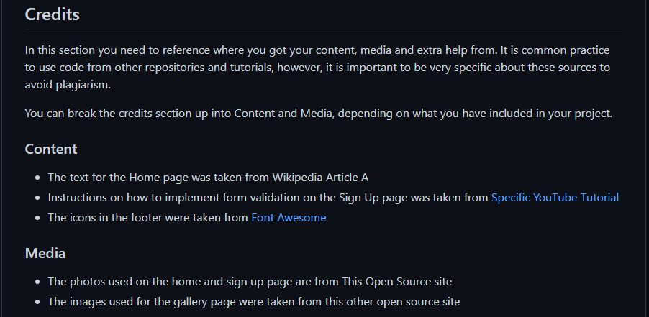
Citation of Sources
Crediting Sources
Always credit ALL sources
Images
Code
Text
Link to relevant site
Authors name/pseudonym
Link to actual content

Slide 10
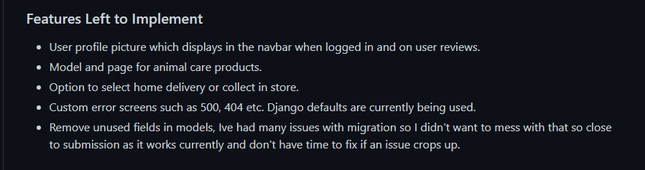
Future Features
Features you did not add yet
You ran out of time
You weren’t sure if it was viable
Weren’t comfortable implementing

Slide 11
Summary
As you can see the README is a crucial part of your projects and writing a well-documented README is a skill. By the time you graduate you will be comfortable with markdown and writing good software documentation.
The README should be started with your project and never as an afterthought. This way you can add any bugs that crop up and ideas you may have a long the way. The README is your direct line of communication to the Assessor within this course and to a potential client/collaborator in your career as a developer. This is a powerful tool for communicating your ideas and process and should be treated with the utmost importance.

Slide 12
Project examples
Thrive
Repository
Repository
Deployed
Deployed
Batala Bangor Website
Repository
Repository
Repository
Deployed
Deployed
Bodelschwinger Hof
Repository
Deployed

